Slide 1
Desenhos organizacionais contemporâneos
11
11 - 1

Slide 2
objetivos
Descrever desenhos organizacionais contemporâneos.
Descrever como as organizações se podem organizar para potenciar a colaboração.
Explicar formas de trabalho flexível utilizadas pelas organizações.
Descrever problemáticas na organização associadas a uma força de trabalho de contingência.
Descrever os desafios atuais do desenho organizacional.
11- 2

Slide 3
Desenhos organizacionais contemporâneos
Estrutura de equipa – toda a organização está estruturada em equipas de trabalho.
Estrutura matricial – estrutura em que especialistas de diferentes departamentos funcionais trabalham para um ou mais projetos/produtos.
11 - 3
Notes:
A team structure is one in which the entire organization is made up of work teams that do the organization’s work. In this structure, employee empowerment is crucial because no line of managerial authority flows from top to bottom. Rather, employee teams design and do work in the way they think is best, but the teams are also held responsible for all work performance results in their respective areas.
Other popular contemporary designs are the matrix and project structures. The matrix structure assigns specialists from different functional departments to work on projects being led by a project manager. (See Exhibit 11-2.) One unique aspect of this design is that it creates a dual chain of command because employees in a matrix organization have two managers: their functional area manager and their product or project manager, who share authority. The project manager has authority over the functional members who are part of his or her project team in areas related to the project’s goals. However, any decisions about promotions, salary recommendations, and annual reviews typically remain the functional manager’s responsibility. The matrix design “violates” the unity of command principle, which says that each person should report to only one boss; however, it can—and does—work effectively if both managers communicate regularly, coordinate work demands on employees, and resolve conflicts together.

Slide 4
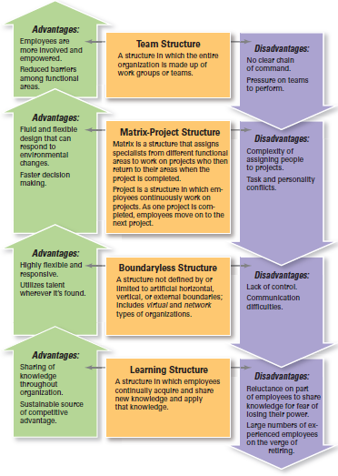
Figura 11-1: desenhos organizacionais Contemporâneos
11 - 4

Slide 5
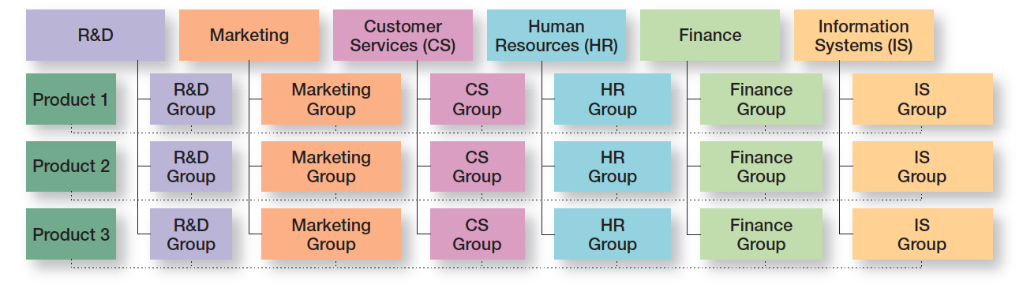
Figura 11-2
Exemplo de um Desenho Organizacional matricial
11 - 5

Slide 6
Desenhos organizacionais contemporâneos (cont.)
Estrutura por projetos – estrutura na qual os empregados trabalham continuamente em projetos.
Organização sem fronteiras (Boundaryless Organization) – organização cujo desenho não é definido nem limitado por uma estrutura pré-determinada, não tendo fronteiras horizontais, verticais ou externas).
11 - 6
Notes:
Many organizations use a project structure, in which employees continuously work on projects. Unlike the matrix structure, a project structure has no formal departments where employees return at the completion of a project. Instead, employees take their specific skills, abilities, and experiences to other projects. Also, all work in project structures is performed by teams of employees.
The boundaryless organization, is an organization whose design is not defined by, or limited to, the horizontal, vertical, or external boundaries imposed by a predefined structure. Although the idea of eliminating boundaries may seem odd, many of today’s most successful organizations find that they can operate most effectively by remaining flexible and unstructured: that the ideal structure for them is not having a rigid, bounded, and predefined structure.

Slide 7
Desenhos organizacionais contemporâneos (cont.)
Organização virtual
Organização que consiste num núcleo de empregados a tempo inteiro, recrutando especialistas externos temporariamente, quando necessário para levar a cabo projetos.
11 - 7
Notes:
A virtual organization typically consists of a small core of full-time employees and outside specialists temporarily hired as needed to work on projects. An example is when Second Life, a company creating a virtual world of colorful online avatars, was building its software. Founder Philip Rosedale hired programmers from around the world and divided up the work into about 1,600 individual tasks, “from setting up databases to fixing bugs.” The process worked so well, the company used it for all sorts of work.

Slide 8
Desenhos organizacionais contemporâneos (cont.)
Organização em rede (Network Organization)
Organização que utiliza os seus próprios empregados para algumas tarefas, e redes externas de fornecedores para alguns dos componentes necessários aos produtos ou para alguns processos de trabalho.
Organização que aprende (Learning Organization)
Organização que desenvolve as capacidades de continua aprendizagem, adaptação e mudança.
11 - 8
Notes:
A network organization is one which uses its own employees to do some work activities and networks of outside suppliers to provide other needed product components or work processes. This organizational form is sometimes called a modular organization by manufacturing firms. Such an approach allows organizations to concentrate on what they do best by contracting out other activities to companies that do those activities best.
A learning organization, is an organization that has developed the capacity to continuously learn, adapt, and change. In a learning organization, employees continually acquire and share new knowledge and apply that knowledge in making decisions or doing their work. Some organizational theorists even go so far as to say that an organization’s ability to do this—that is, to learn and to apply that learning—may be the only sustainable source of competitive advantage.

Slide 9
Potenciar a Colaboração
Colaboração Interna
  Equipa multi-funcional (Cross-functional team) – equipa composta por indivíduos de várias áreas funcionais.
  Task force (ou comité ad hoc) – comité ou equipa temporária, formada para dar resposta, no curto prazo, a um problema que afeta vários departamentos.
11 - 9
Notes:
When managers believe collaboration among employees is needed for more coordinated and integrated work efforts, they can use several different structural options. Some of the more popular include cross-functional teams, task forces, and communities of practice.
A crossfunctional team is a work team composed of individuals from various functional specialties. When a cross-functional team is formed, team members are brought together to collaborate on resolving mutual problems that affect the respective functional areas. Ideally, the artificial boundaries that separate functions disappear, and the team focuses on working together to achieve organizational goals.
Another structural option organizations might use is a task force (also called an ad hoc committee), a temporary committee or team formed to tackle a specific short-term problem affecting several departments. The temporary nature of a task force is what differentiates it from a cross-functional team. Task force members usually perform many of their normal work tasks while serving on the task force; however, the members of a task force must collaborate to resolve the issue that’s been assigned to them. When the issue or problem is solved, the task force is no longer needed and members return to their regular assignments.

Slide 10
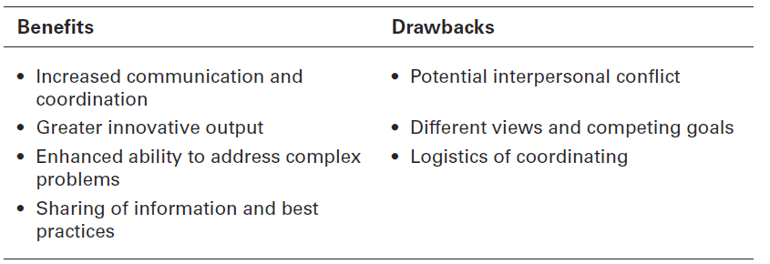
Figura 11-3 vantagens e desvantagens da colaboração
11 - 10

Slide 11

colABORAÇÃO INTERNA
Comunidades de práticas
Grupos de pessoas que partilham uma preocupação, um conjunto de problemas ou uma paixão por um assunto, e que interagem para aprofundar o seu conhecimento e competências nessa área.
11 – 11
Notes:
Communities of practice, are types of internal collaborations which are “groups of people who share a concern, a set of problems, or a passion about a topic, and who deepen their knowledge and expertise in that area by interacting on an ongoing basis.

Slide 12
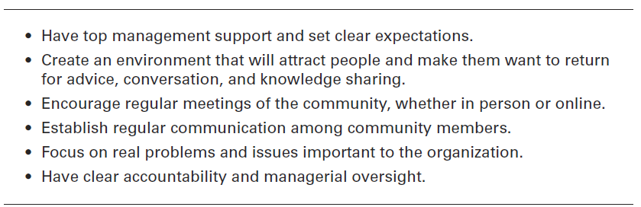
figura 11- 4 como conseguir que as comunidades de práticas funcionem
11 - 12

Slide 13
Colaboração externa
Inovação aberta – abrir a procura de novas ideias para além das fronteiras da organização e permitir que as inovações sejam facilmente transferidas, para dentro e para fora.
Parcerias estratégicas – relações de colaboração entre duas ou mais organizações, que combinam os seus recursos e capacidades para uma finalidade específica.
11 - 13
Notes:
Today, many companies are trying open innovation, opening up the search for new ideas beyond the organization’s boundaries and allowing innovations to easily transfer inward and outward. For instance, Procter & Gamble, Starbucks, Dell, Best Buy, and Nike have all created digital platforms that allow customers to help them create new products and messages.
In today’s environment, organizations are looking for advantages wherever they can get them. One way they can do this is with strategic partnerships, collaborative relationships between two or more organizations in which they combine their resources and capabilities for some business purpose.

Slide 14
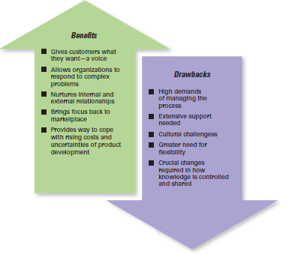
Figura 11-5
Vantagens e desvantagens da inovação aberta
11 – 14

Slide 15

Formas de trabalho flexível
Teletrabalho – os empregados trabalham em casa e estão ligados à organização por computador.
Semana de trabalho comprimida – os empregados trabalham mais horas por dia e menos dias por semana.
11 - 15
Notes:
Telecommuting is a work arrangement in which employees work at home and are linked to the workplace by computer. Needless to say, not every job is a candidate for telecommuting, but many are.
One approach to flexible work arrangements is a compressed workweek, a workweek where employees work longer hours per day but fewer days per week. The most common arrangement is four 10-hour days (a 4–40 program).

Slide 16
Formas de trabalho flexível
Horário flexível – os empregados têm de cumprir um número específico de horas por semana mas, dentro de limites estabelecidos, podem variar os horários. (ex.: chegar entre as 8h e as 10h e sair entre as 17h e as 19h).
Partilha de função / posto de trabalho – duas ou mais pessoas partilham um posto de trabalho de horário completo (ex.: uma de manhã e outra à tarde).
11 - 16
Notes:
Another alternative is flextime (also known as flexible work hours), a scheduling system in which employees are required to work a specific number of hours a week but are free to vary those hours within certain limits. A flextime schedule typically designates certain common core hours when all employees are required to be on the job, but allows starting, ending, and lunch-hour times to be flexible.
Job sharing is the practice of having two or more people split a full-time job. Many companies have used job sharing during the economic downturn to avoid employee layoffs.

Slide 17
Força de trabalho de contingência
Força de trabalho de contingência
Trabalhadores temporários, freelancers ou com contrato a prazo, que dependem da existência de necessidade dos seus serviços.
11 - 17
Notes:
Contingent workers are temporary, freelance, or contract workers whose employment is contingent on demand for their services. Some are now referring to these workers as the independent work force, since there’s no dependent relationship between worker and organization.

Slide 18
Desafios atuais para o desenho organizacional
Manter os empregados em contacto
Os computadores portáteis e as tecnologias de comunicação permitem às organizações e aos empregados estarem em contacto, uns com os outros, e assim serem mais produtivos.
  Ex: e-mail, calendários, redes wireless, vídeo conferências e webcams.
11 - 18
Notes:
Mobile computing and communication technology have given organizations and employees ways to stay connected and to be more productive. For instance, handheld devices have e-mail, calendars, and contacts that can be used anywhere there’s a wireless network. And these devices can be used to log into corporate databases and company intranets. Employees can videoconference using broadband networks and Webcams. Many companies are giving employees key fobs with constantly changing encryption codes that allow them to log onto the corporate network to access e-mail and company data from any computer hooked up to the Internet.

Slide 19
Desafios atuais para o desenho organizacional (cont.)
  Preocupações inerentes à globalização
  Quando desenham ou modificam uma estrutura, os gestores têm de pensar nas implicações culturais de alguns elementos.
  Exemplo
  A formalização pode ser mais importante nos países menos desenvolvidos, e menos importante nos países mais desenvolvidos (os empregados têm provavelmente maiores níveis de escolaridade e de formação profissional).
11 - 19
Notes:
Researchers have concluded that the structures and strategies of organizations worldwide are similar, “while the behavior within them is maintaining its cultural uniqueness.” When designing or changing structure, managers may need to think about the cultural implications of certain design elements. For instance, one study showed that formalization—rules and bureaucratic mechanisms—may be more important in less economically developed countries and less important in more economically developed countries where employees may have higher levels of professional education and skills.
No matter what structural design managers choose for their organizations, the design should help employees do their work in the best—most efficient and effective—way they can. The structure should support and facilitate organizational members as they carry out the organization’s work. After all, an organization’s structure is simply a means to an end.

Slide 20


